Slide 1

Finding Nemo: How far did they go?
Group 5: Johnnie, Liana, Maya, Spencer, Stella
Notes:
Welcome to a fascinating journey into the depths of the ocean. My name is Johnnie, Liana, Maya, Spencer, and Stella and we will guide you through our project titled "Finding Nemo: How Far Did They Go?" dives into the depths of research to determine the distances traveled by these real-life underwater stars. Let’s start at the beginning, the data collection and cleaning process.
Picture this: a sea of information in the form of .csv files. We meticulously sifted through the data, filtering out exceptions and renaming missing entries to 'NA.’ For our endurance dataset, we decided to make a detour, excluding the location of Boston State University. We kept the essential variables - year, longitude, latitude, and species, adjusting the nameused to species for clarity.
The endurance dataset revealed fascinating insights into the development of swimming endurance in reef fish.
**FUN FACT**
If the female of the group dies, the dominant male fish will turn permanently female and the largest of the smaller males will become the next dominant male.

Slide 2
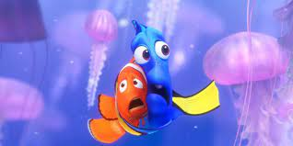
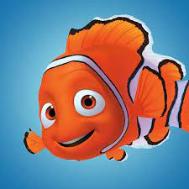
How long would it take Marlin and Dory to travel to SYdney, australia from where they start out in the beginning of the movie?
Notes:
We were inspired by Finding nemo, asked ourselves how far would they have to travel to get to nemo based on where they lived?
Now, let's plunge into the methods and unveil the mysteries behind our research. You'll be taken on a visual journey through various plots and tables, providing a comprehensive understanding of the clownfish and blue tang.

Slide 3


Notes:
We had 2 data sets, one with the geographical locations of the clown fishes and blue tangs, the most likely species of the fish in the movie, and the other that shows the endurance of the clownfish species and how far they travel over time.
We used both because they worked well with each other and were fairly small
Started by downloading the data
Got rid of any remarks of unnecessary columns for our question
Replaced all irrelevant data with NAs
Renamed some data to make it easier to work with

Slide 4
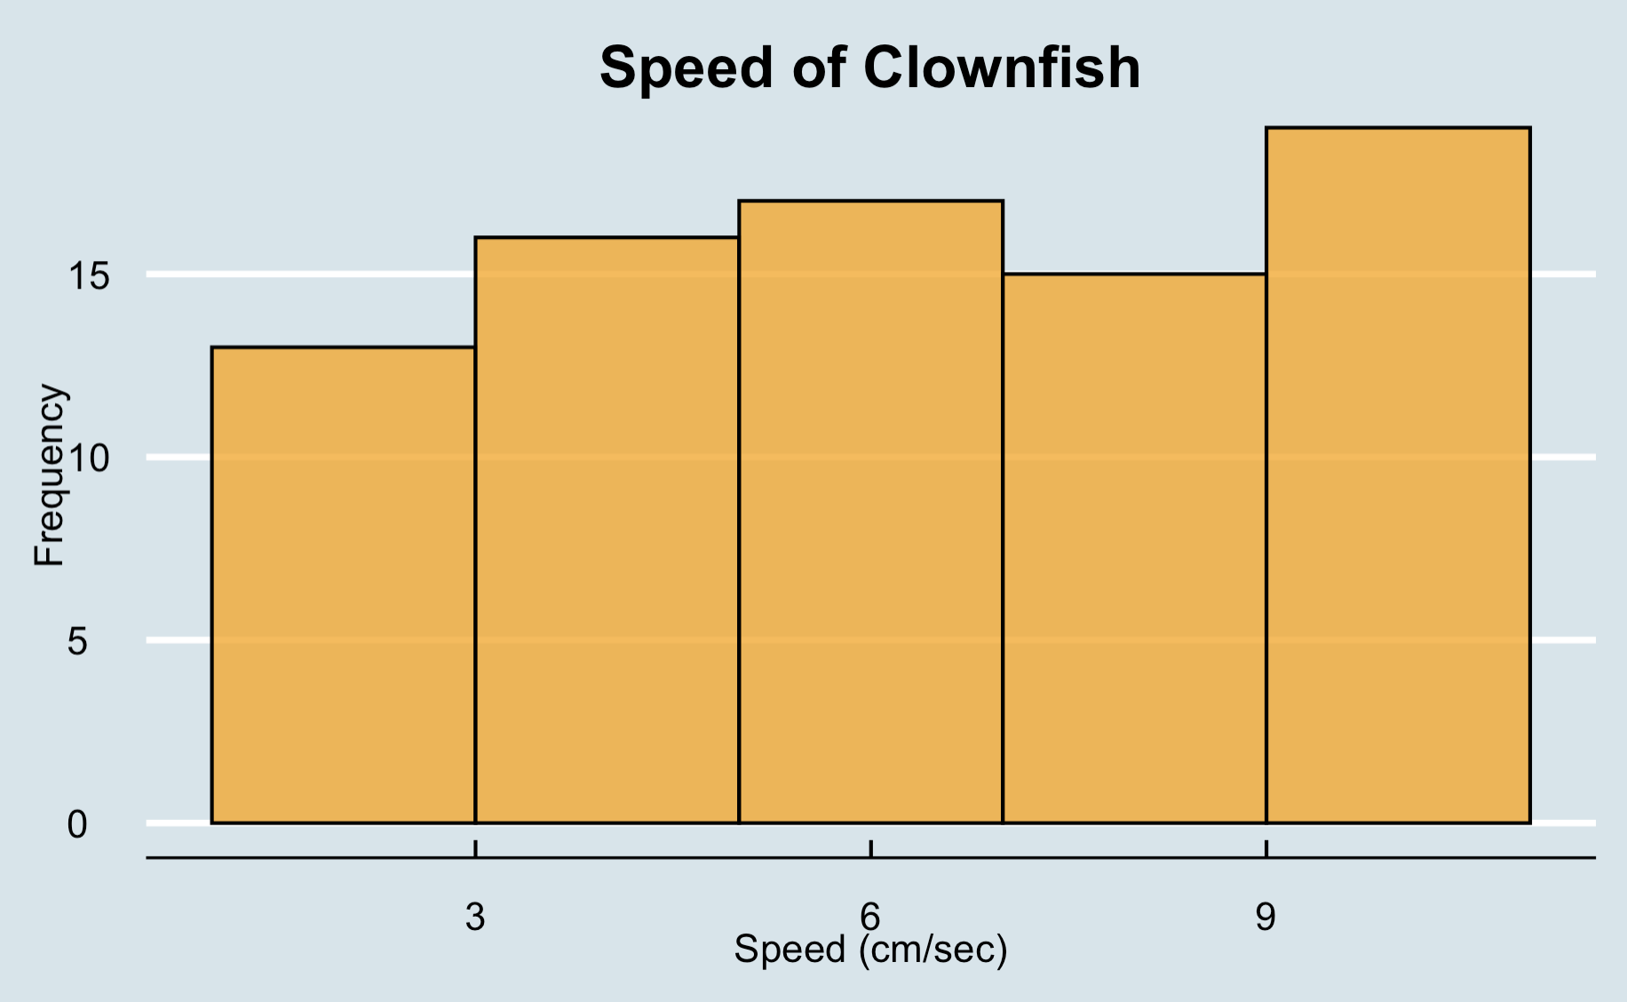
Notes:
-Histogram for the distribution for the measured speeds of the clownfish
- Minimum speed of 2 cm/s and a maximum of 10 cm/s
As noted by the endurance paper: The swimming endurance of larvae, especially Amphiprion percula, increases significantly with age.

Slide 5
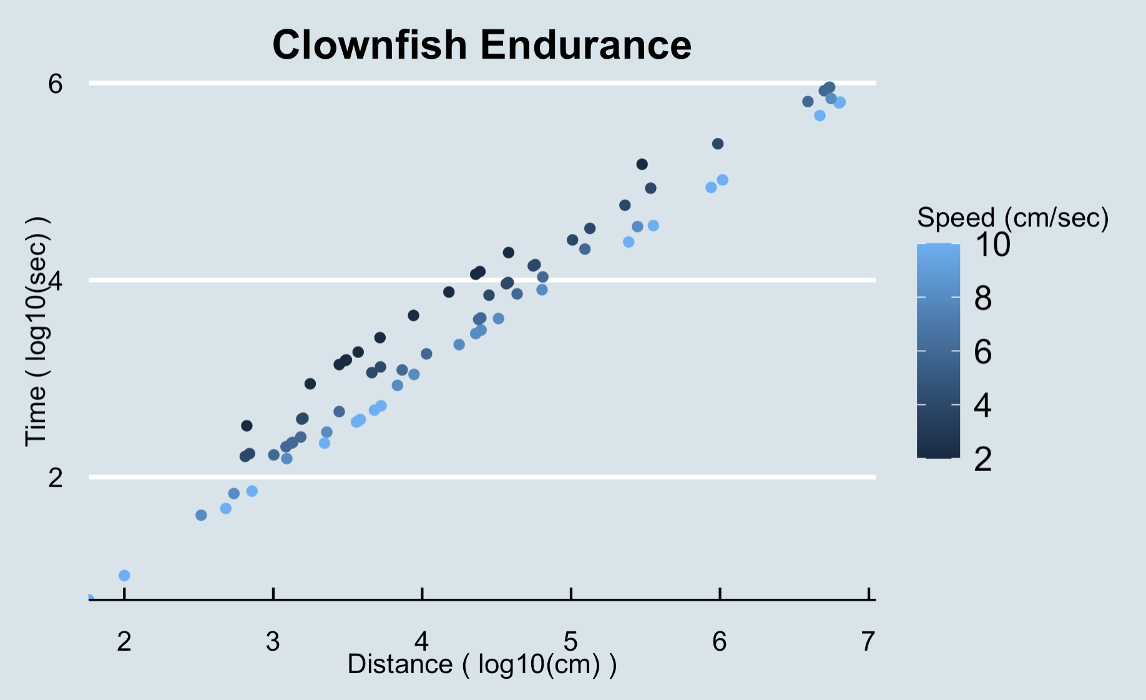
Notes:
Scatter plot for graphing the distance and time, log10 transformation for both axis was the clearest way to visualize the data
The coloring of the dots is done by speed
The variables had to be put on a log scale to better show the relationship between the variables and account for outliers in the data
Graphs visualizes how the faster the speed of the clownfish, the less time it takes for fish to swim a distance
Maximum measure distance of 6 km
From the paper: Furthermore, our findings indicate that swimming durations decrease with increasing flow velocity, but strong swimming abilities play a crucial role in maintaining consistent durations across various flow velocities.

Slide 6
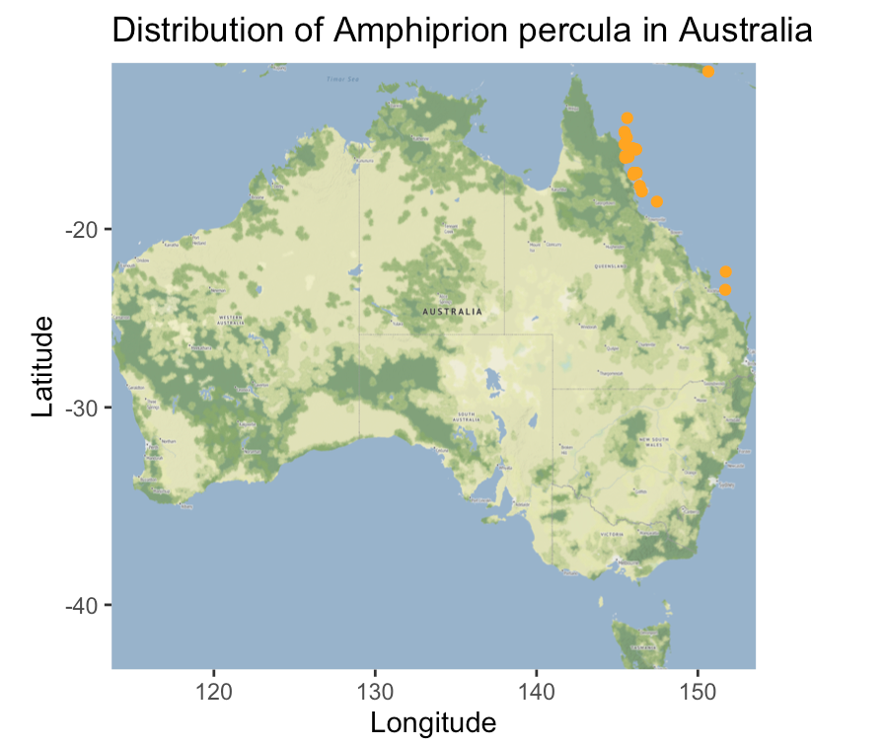
Notes:
But that's not all; our journey continues with finding where the species are located. Here is a map of the longitude and latitude of Amphirion Percula (Marlin) in Australia.
The species ranges from Northern Queensland(point part of Australia) to Melanesia (ocean to the right of the graph). With a latitude around -18 and a longitude around 146.

Slide 7
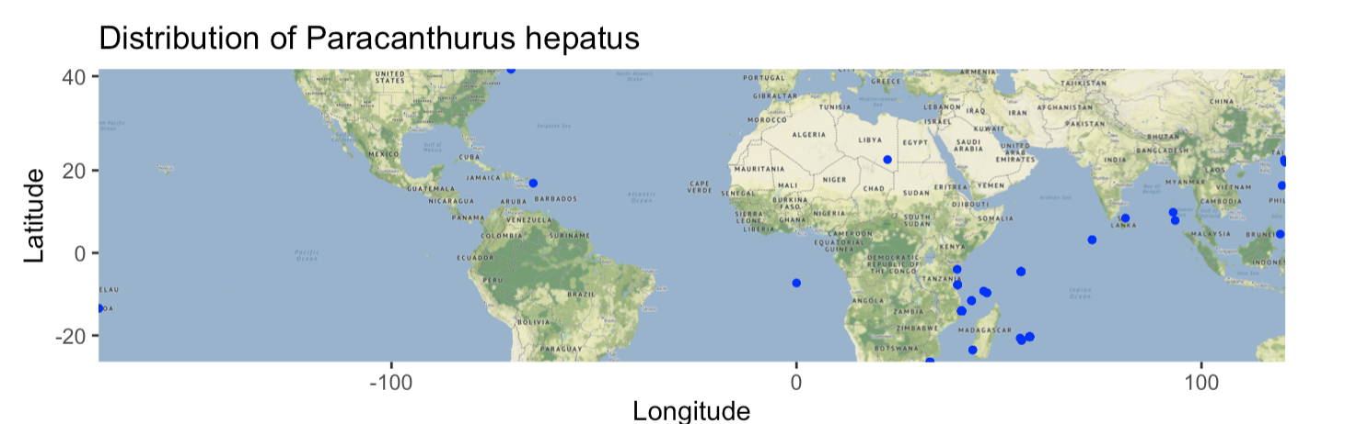
Notes:
Here is a map of where we can find Paracanthurus Hepatus (Dory) generally between 30° north & south latitude to 170° west longitude. They breed all year long but, the time of year varies with location and water temperature. (Dec-June)

Slide 8
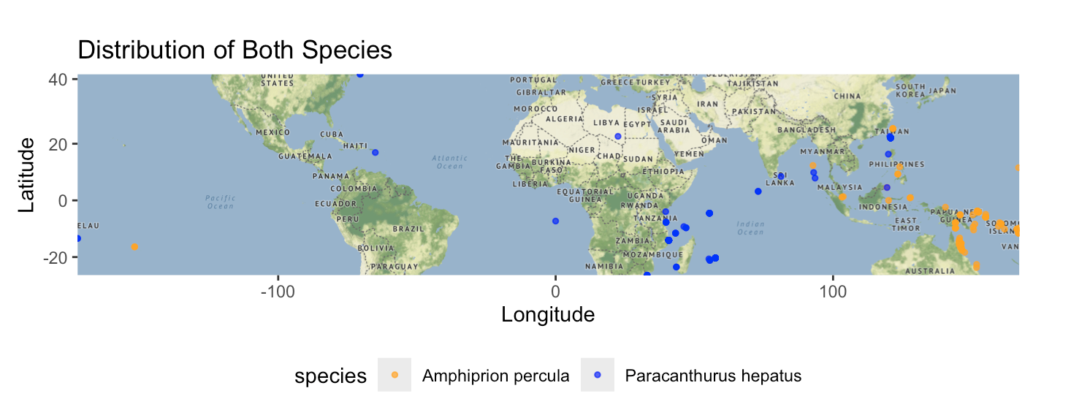
Notes:
This map merges the location of both the (Marlin) and (Dory) as they are native to the Indo-Pacific Region. In this map we notice that the two species are separated from each other. Possible explanations for the difference in location is small sample size of data collected, or migration of the blue tang during mating season. We also hypothesize that swimming ability can also influence the dispersal of the fish.

Slide 9
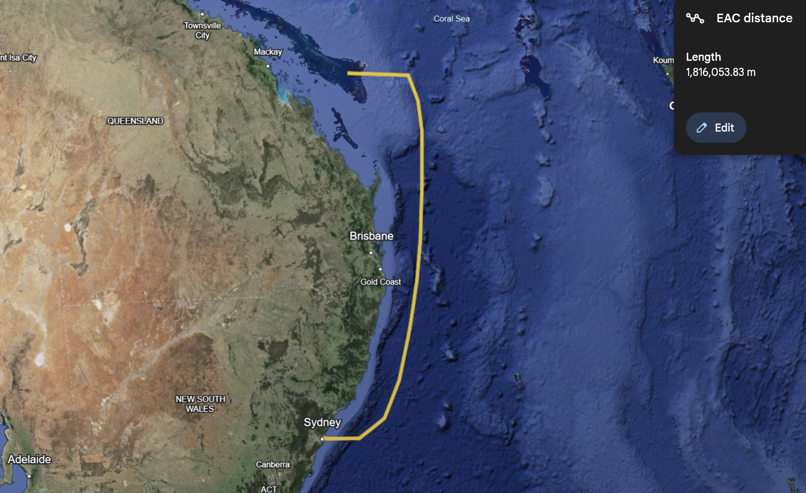
Notes:
The Great Barrier Reef is part of a larger system of ocean circulation in the Pacific Ocean.

Slide 10
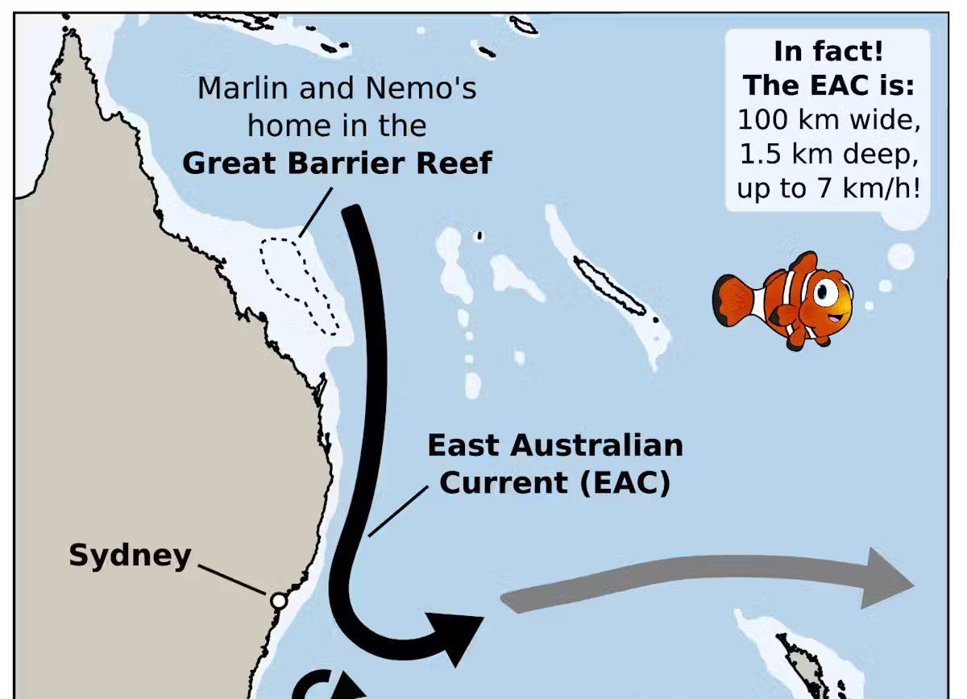

Slide 11
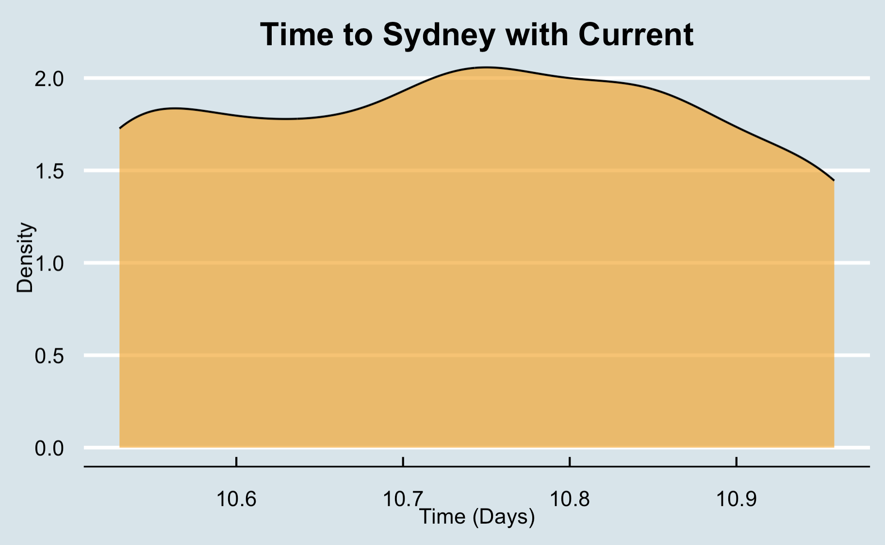
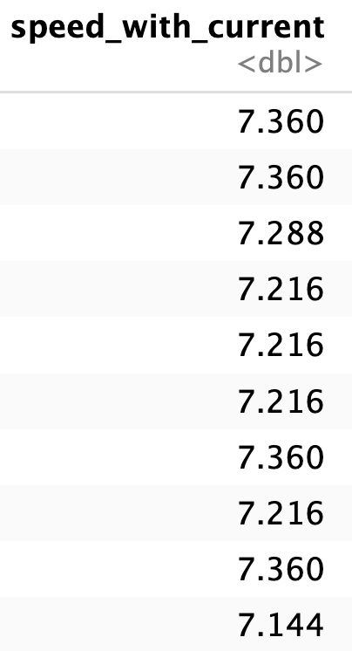
Notes:
Mutated speed data from centimeters per second variable into kilometers per hour variable
Added the avg speed of the East Australian current to the speed data to get a more accurate gauge of the length of journey
Created a new variable to calculate the number of days it would for the clownfish to travel from the Great Barrier Reef to Sydney, Australia.
Plotted the time, in days, it would take to swim with the current to Sydney

Slide 12
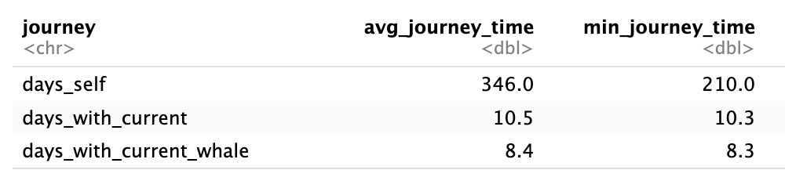

Slide 13
Now presenting our app!

Slide 14
Thank You!
Notes:
Now I would like to showcase the app that we developed that summarizes our data so it is easily visible and accessible.
Our application features dedicated tabs, each highlighting a specific graph for clear and convenient navigation.
In conclusion, our study suggests a correlation between swimming abilities and long-distance dispersal in reef fish. This knowledge emphasizes the importance in understanding population connectivity for possible marine conservation strategies.
Thank you for joining us on this underwater adventure, (where we've navigated the currents of data, explored the depths of swimming capabilities, and uncovered the mysteries of the clownfish and blue tang. Until next time, (and thank you for your time!)

